Slide 1
Chapter 35 War and Revolution in China and Vietnam
Cristian Sifuentes
Eduardo Tzapin
Jessica Briseno
Cristian Franco
Edgar Sanchez
Cruz Aguilar
Alex Reyna
Uto Udoh

Slide 2
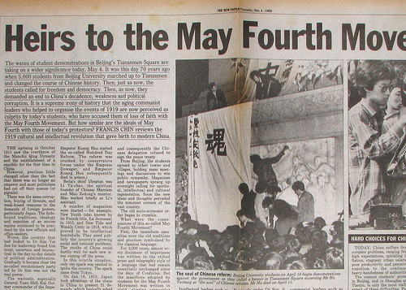
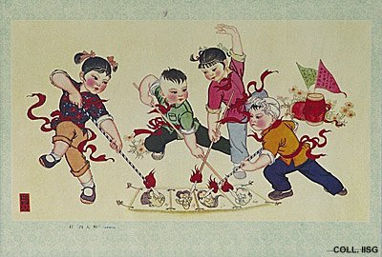
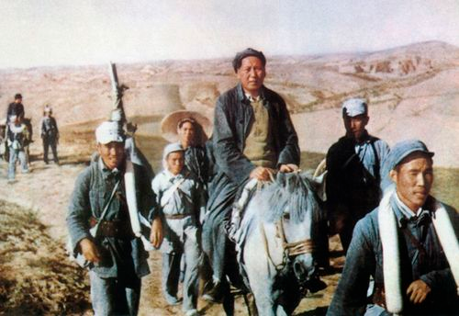
Main Events
Notes:
Top left (May Fourth Movement article); Bottom middle (Long March); Top right (a group of children smashing Gang of Four)

Slide 3
May Fourth Movement
Resistance to Japanese encroachments in China began on this date in 1919
Spawned movement of intellectuals aimed at transforming China into a liberal democracy
Rejected Confucianism
Long March
Communist escape from Hunan province during civil war with Guomindang in 1934
Center of communist power moved to Shaanxi province
Firmly established Mao Zedong as head of the Communist party in China
Gang of Four
Jiang Qing and four political allies who attempted to seize control of Communist government in China from the pragamists
Arrested and sentenced to life imprisonment in 1976 following Mao Zedong’s death

Slide 4
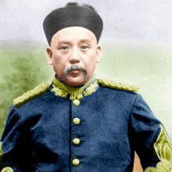
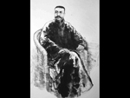
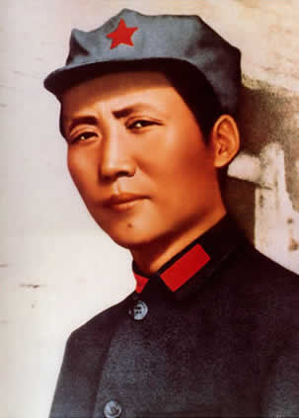
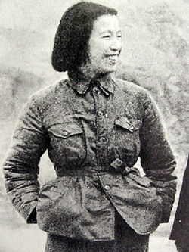
Key People
Notes:
Top left (Sun Yat-sen); Top middle (Yuan Shikai); Top right ( Li Dazhao); Bottom left (Mao Zedong); Bottom right (Jiang Qing)

Slide 5
Sun Yat-sen
Head of Revolutionary Alliance, organization that led 1911 revolt against Qing dynasty in China
Briefly elected president in 1911, but yielded in favor of Yuan Shikai in 1912
Created Nationalist party of China (Guomindang) in 1919
Died in 1925
Yuan Shikai
Warlord in northern China after fall of Qing dynasty
Hoped to seize imperial throne
President of China after 1912
Resigned in the face of Japanese invasion in 1916
Li Dazhao
Chinese intellectual who gave serious attention to Marxist philosophy
Headed study circle at the University of Beijing
Saw peasants as vanguard of revolutionary communism in China
Mao Zedong
Communist leader in revolutionary China
Advocated rural reform and role of peasantry in Nationalist revolution
Influenced by Li Dazhao
Led Communist reaction against Guomindang purges in 1920s, culminating in Long March of 1934
Seized control of all mainland China by 1949
Initiated Great Leap Forward in 1958
Jiang Qing
Wife of Mao Zedong
One of Gang of Four
Opposed pragmatists and supported Cultural Revolution of 1965
Arrested and imprisoned for life in 1976

Slide 6
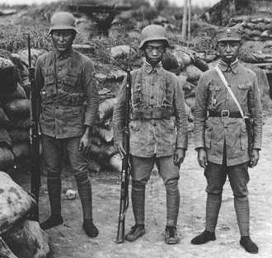
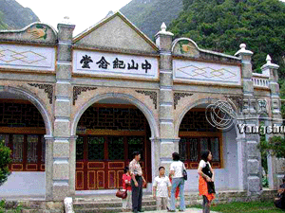
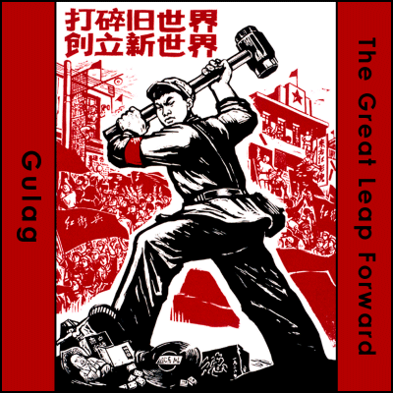
Important Concepts
Notes:
Top left (Socialist Youth Corps); Top middle (Guomindang); Top right (Whampoa Military Academy); Bottom left (People’s Republic of China); Bottom right (Great Leap Forward)

Slide 7
Socialist Youth Corps
Formed in 1920 in China
Dedicated to recruiting urban working classes to the nationalist revolution in China
Guomindang
Chinese Nationalist party founded by Sun Yat-sen in 1919
Drew support from local warlords and Chinese criminal underworld
Initially forged alliance with Communists in 1924
Dominated by Chiang Kai-shek after 1925
Whampoa Military Academy
Founded in 1924
Military wing of the Guomindang
First head of the academy was Chiang Kai-shek
People’s Republic of China
Communist government of mainland China
Proclaimed in 1949 following military success of Mao Zedong over forces of Chiang Kai-shek and the Guomindang
Great Leap Forward
Economic policy of Mao Zedong introduced in 1958
Proposed industrialization of small-scale projects integrated into peasant communes
Led to economic disaster
Ended in 1960

Slide 8
5 AP Themes
Interaction
Change and Continuity (Staying the Same)
Technology and Demography (Population)
Social Structures and Gender Structure
Changes in Functions and Structures of State

Slide 9
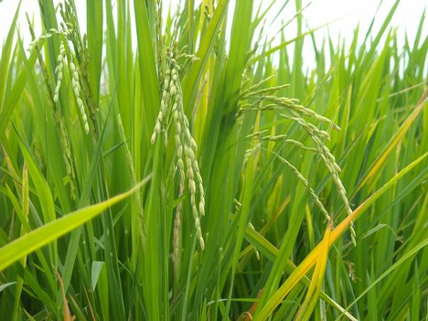
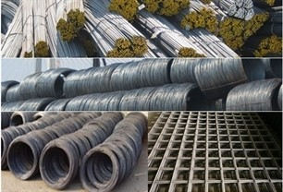
Interaction

Slide 10
Economy
Land from landlords was taken and redistributed to peasants who had none or little land.
Communist saw rapid industrialization as the key to successful development with the Stalin five year plan in 1953 that turned away form the peasantry towards urban workers to build up China.
Had little foreign assistance from either the West or the Soviets so the state resorted to draw resources from the countryside to finance industrial growth.
During the Great Leap industrialization would be pushed through small scale projects rather than huge plants. Publicity was given to efforts to produce steel that relied on labor rather than machines.
After a few months the Great Leap Forward was leading China to an economic disaster. Drought caused famine to spread across China made China import large amounts of food to support their people.
Population increase overwhelmed productivity agricultural and industrial sectors.

Slide 11
Change and Continuity (Staying the Same)

Slide 12
Changes
China and Vietnam have retained deeply ingrained suspicions of the commercial and entrepreneurial classes
Both continue to stress that those who wield political power are obligated to rule in ways that promote the welfare of the mass of the people
Both still adhere to ideological systems that stress secularism, social harmony, and life in this world rather than religious concerns and life hereafter
Continuities
Chinese and Vietnamese revolutionaries struggled to build new societies that owed much to their Confucian past
China and Vietnam’s ideas and patterns of civilized life have been nurtured over a millennia

Slide 13
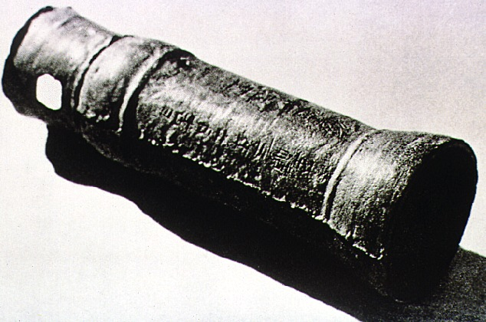
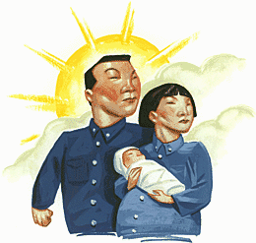
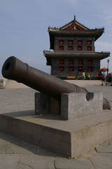
Technology and Demography (Population)
Notes:
Top left (gunpowder); Bottom left (cannon); Right (One Child Cartoon)

Slide 14
Technology
Weapons were brought for war
Gunpowder and ships that would help them out in the wars
Also had cannons
Demography
Famines and diseases in China had decreased the population
China had a made a plan to keep the families under control so they made a plan where the parents could only have one child to keep the deaths of famine from increasing

Slide 15
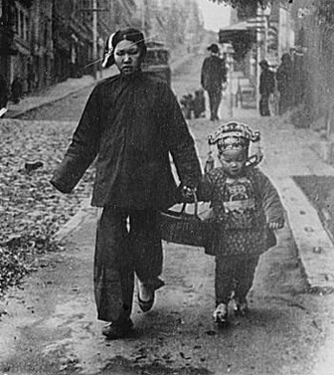
Social Structure and Gender Structure

Slide 16
Social Structure
Government in 1960 launched a family plan to limit urban couples to two children to a couple.
1980’s only one child to couple.
Monarchies/ Autocratic regimes were replaced with Cadres.
Scholar gentry and land lords were eliminated from social class.
Revolutionaries became ruling class
Class system was set up as
Cadres ( communist party)
State workers
Peasants
Gender Structure
Mainly children and women worked in cotton mills
Helping the women get rights was part of Mao’s plan
Women got rid of foot-binding.
Women served as teachers, nurses, truck drivers and spies.
With the win of the revolution women had gained equal rights in China.
1949 women gain right to education and professional careers.

Slide 17
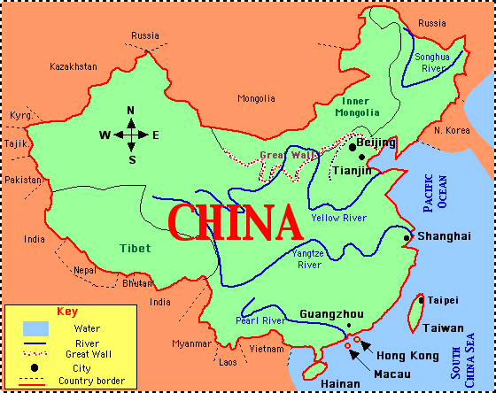
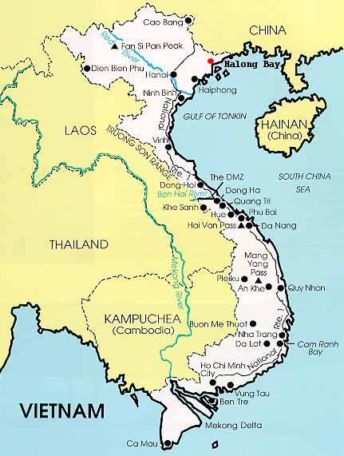
Changes in Functions and Structures of State
Notes:
Left (China); Right (Vietnam)

Slide 18
Religion
The May Fourth movement made Confucianism ridiculed and rejected in favor of a wholehearted acceptance of all that the western democracies had to offer
The communist party was small but the communists at least offered a clear alternative to fill the ideological and institutional void left by the collapse of the Confucian order
Families and parents had been instilled for millennia by Confucian teachings
The collapse of Confucian order also ushered in decades of severe crisis and brutal conflict in which women’s survival depended on their assumption of radically new roles and their active involvement in revolutionary activities
The Vietnamese had long molded their polity on the Confucian system of their giant neighbor to the north and had borrowed heavily from China in the social and cultural spheres, their encounter with the expansive West had much in common with of the Chinese
As in China and Korea the failure of the Confucian elite in Vietnam to ward off the intrusions of the West led to the rejection of Confucian civilization as a whole

