Slide 1
Chapter 33: Decolonization and the Decline of the European World Order
By:
Linda Valadez, Diana Santiago, Mark Rodriguez, Omar Flores, Jennifer Campos, Cervando Acosta, Jazzmin Readeaux

Slide 2
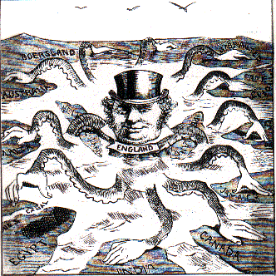
Introduction
After colonialism, Asia and Africa start deciding on what to keep from their own cultures as well as what deals needed to be made with the West
Revival of traditional beliefs and political structures was critical to decolonization
Decolonization began with Western-educated middle classes in the colonized areas
Indigenous leaders expelled foreigners through peaceful diplomatic ways
World War I weakened the Western colonialists so that movements against the West arose
World War II European powers unable to maintain the colonial structure

Slide 3
First Phases of Decolonization in India and Egypt
India and Asian colonies were colonized before Africa
Were also first to make independence movements
Western- educated minorities organized politically to end Imperialism
India and Egypt are examples of early decolonization movements

Slide 4
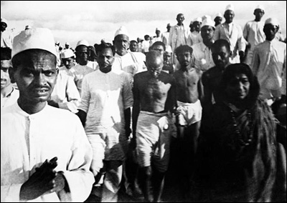
India: Nationalist challenge British Raj
1885- Groups of Western-educated Indians in major cities made the Indian National Congress party
At first they only presented the British government with present problems in the society
Most of the issues concerned the Indian elite, not the poor
The group created a sense of Indian identity

Slide 5
Social Bases of a Mass Movement
British economic and social policies helped get support for the Congress Party
Indians had to pay huge costs for the colonial army, high-salaried bureaucrats, and the importation of British manufactured goods- they were getting tired of it for money isn't going to them
Many problems within peasantry (i.e. food shortage)
nationalists blame this on British policies that encouraged peasants to shift from the production of food to commercial crops- this caused more resentment towards the British Raj, also accusing them of indifference

Slide 6
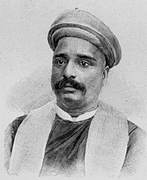
The Rise of Militant Nationalism
Nationalist B.G. Tilak emphasized Hindu bases of the movement
Tilak urged the boycott of British manufactured goods
Tilak's support for violence against the British regime surfaced, he was arrested and deported to Burma.
Terrorist groups favored secret organizations that targeted British officials and public buildings.
Peaceful protests like Gandhi’s gained more support
Lawyers within the Congress party emerged as leaders of the nationalist movement.

Slide 7
Egypt and the Rise of Nationalism in the Middle East
British occupation after the Ahmad Orabi Rebellion, left Egyptians with both Turkish khedives and British overlords.
Lord Cromer (High Commissioner) directed British policy in Egypt (attempt eco. reforms and improve irrigation)- but brought little benefit
Great estates monopolized Egyptian land
Resistance came from Egyptian business classes while journalists attacked the British racial attitudes
To prevent more violence, Britain grants a new constitution to Egypt that included parliamentary representation.
When WWI broke out, the British suspended the constitution and imposed martial law (an end to nationalist agitation)

Slide 8
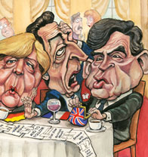
WWI and the Postwar Crisis of the European Empires
WWI boosted nationalist movements by weakening European powers.
Many African and Asian troops were recruited for European armies during war
Colonies served as important sources of food and raw materials.
During war, European vulnerability became evident.
As troops were withdrawn from the, Africans and Asians fill posts previously reserved for European
To keep support, European nations made false promises of independence

Slide 10
India: Gandhi and the Nationalist Struggle
The White Dominions and India within the British Empire were important in WWI.
Even nationalist leaders of India supported the war effort.
Wartime inflation reduced living standards among Indian peasants and famine arose in some regions.
After the war, nationalists were frustrated by British refusal of independence
The initial promise of the Montagu-Chelmsford reforms of 1919 was offset by the Rowlatt Act, which limited Indian civil rights.

Slide 11
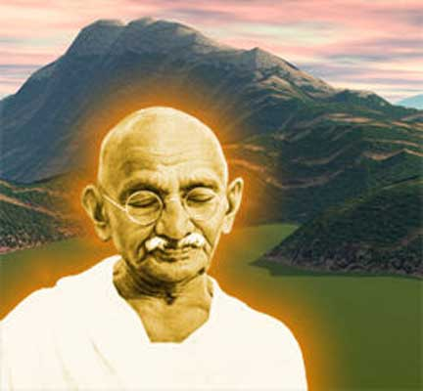
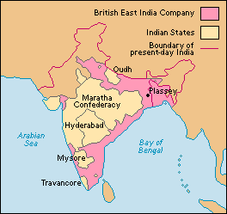

Slide 12
Rise of Communalism and Early Political Fragmentation
Was hard for Gandhi to convince Muslim League (1906) and Hindu extremists
Gandhi's attempts to repeal the Rowlatt Act revealed strengths and weaknesses of his movement. When his campaign turned violent, he called it off
Gandhi was imprisoned by the British
Unrest renewed in response of Simon Commission's consideration of British responses to nationalism, but then came a wave of nationalism revival
Gandhi retook the campaign with the Salt March of 1931, which forced the colonial government to compromise
The British opened all provincial governments to Indian leaders in the Government of India Act of 1935.

Slide 13
The Middle East: Betrayal and the Growth of Arab Nationalism
After WWI, Entente powers break promises made to Arabs for independence
Instead, Britain and France forces occupied mandates created within the League of Nations. Arab resistance was common
Arabs were concerned over British mandate in Palestine b/c a Jewish homeland was to be created there
Lord Balfour promised Zionists (1917) that British would support a Jewish homeland in Palestine after the war
Zionism remained a large E. Euro. movement until 1894, when Theodor Herzl mobilized W. Euro. Zionism and formed the World Zionist Organization.
Zionism and British takeover of Palestine decreased trust in European promises of independence
Rising Arab opposition caused British to limit Zionist settlement in Palestine.
Zionists prepared to resist British and Arab opposition
Arabs in Palestine remained virtually without voice in diplomatic negotiations concerning the fate of their region

Slide 14
Revolt in Egypt 1919
British made peasantry discontent during the war(drained food, forced labor and confiscated animals.)
Since Egyptian delegates couldn’t travel to travel to France to themselves so they resigned
British regained control after riots and sent people to see what was wrong but were met with violence- the British leave Egypt after a few years
Egypt had more political independence but did little help the people
Fighting over political power lessened the time put into land reforms

Slide 15
Beginnings Of Liberation Struggle In Africa
France and Britain kept demanding labor and raw goods from Africans
Rebellions and war effort disrupted societies.
Strikes and rebellions went on for promises were not being kept by Britain and France
African nationalists tried rallying up Africans
Psychological bondage led to the negritude literary movement which combated racial stereotyping.
Argue that pre-colonial Africa had better societies where everybody was treated better
Some colonies allowed African representation which caused more political movements
In the 1930’s a new leaders made attacks on British policies and tried to gain support

Slide 16
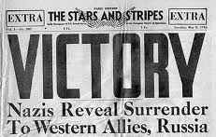
Another global war and the collapse of European world order
World War II proved fatal to the European colonial empires.
European resources were drained from war
Even though the Allies recovered sufficiently to defeat the Axis powers (the Germans and their allies), they were unable to restore the strength of their colonial governments.
Rapid collapse of the Allies in Europe and Asia destroyed illusions of colonial strength.

Slide 17
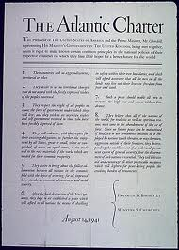
Another Global War Cont.
U.S. and USSR power and influence increased
The U.S. viewed World War II as a war of liberation so they supported nationalist movements in the colonies.
they made a pact with Great Britain called the Atlantic Charter of 1941
It gave the right to choose what form of government people had to obey
The Soviet Union also condemned colonialism.

Slide 18
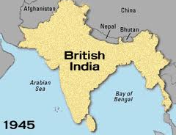
The Winning of Independence in South and Southeast Asia
During WWII, Indian resistance to British Raj produced a campaign of civil disobedience called the Quit India movement.
Only the Muslim League under Muhammad Ali Jinnah supported the war effort.
When a Labour government replaced Winston Churchill's wartime ministry in 1945, the new British ministers began negotiations for independence.
The Muslim League insisted on the creation of separate Muslim and Hindu states.
Fearing a possible sectarian bloodbath, Congress party leaders agreed to the partition of India in 1947.

Slide 19
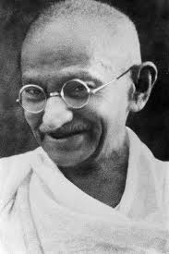
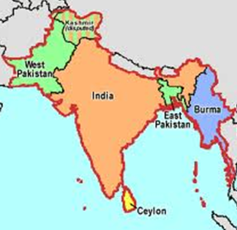
Winning of independence cont.
Congress emerged as the political leaders of independent India, while Jinnah took over in Muslim Pakistan.
Until the borders of the new nations could be secured, violence marred the independence movement.
In 1948, a radical Hindu assassinated Gandhi.
With India gone, the British rapidly arranged for independence in the other Asian colonies such as Burma and Ceylon.

Slide 20
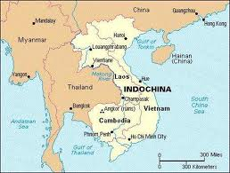
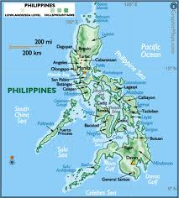
Winning of independence cont.
With the British withdrawal from colonialism, the French, Dutch, and the United States also began the process of decolonization in Asia.
The U.S. granted independence to the Philippines.
Although they resisted nationalist movements, the Dutch withdrew from Indonesia in 1949.
The French continued to hold Indochina, until forced to withdraw.

Slide 21
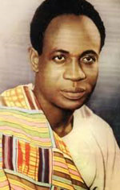
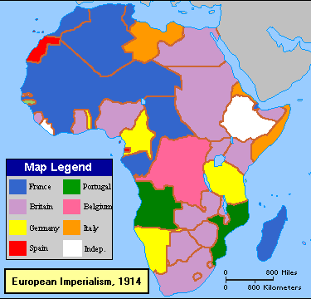
Liberation of Nonsettler Africa
WWII destroyed image of colonizers in Africa
There were 2 paths to decolonization of Africa.
Kwame Nkrumah led a radical ind. movement based on confrontation with the colonial government
Nkrumah’s Convention Peoples party eventually led to British recognition of him as prime minister of Ghana (ind. in 1957)
1960s- other British colonies received independence.
2. France was slower to grant independence
From 1956-1960 most French colonies in Africa gained independence.
Belgians abandoned their colony in the Congo (1960) without any nationalist movement.
Portugal was the only one that attempted to retain control of its African possessions.

Slide 22
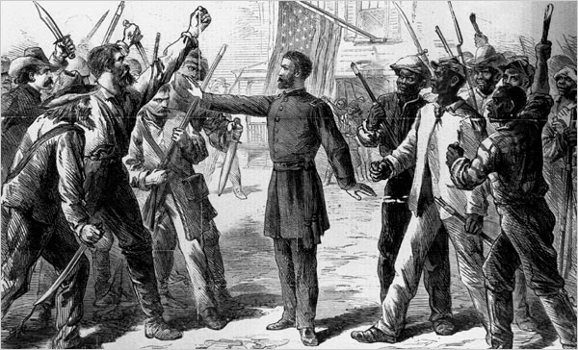
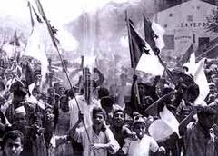
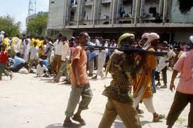
Repression & Guerrilla War: Struggle for the Settler Colonies
Colonies with many whites resisted decolonization.
African groups turned to violence realizing that peaceful movements were unsuccessful
Radicals in Kenya discouraged with the Kenya African Union under Jomo Kenyatta, formed the Land Freedom Army (1950s) & began guerrilla war against whites and the British government
British was able to defeat the military threat, and agreed to negotiations for decolonization with Kenyatta.
Kenya became independent in 1963.
Algeria struggled for independence and was bloodier.
National Liberation Front began a guerrilla war against the French in the 1950s, but independence negotiations began until 1958.
The OAS attempted to kill Charles de Gaulle and overthrow the French government to undo the independence agreements.

Slide 23
The Persistence of White Supremacy in South Africa
Only in South Africa did the white minority still have power
Afrikaner population of South Africa had no European homeland to retreat and regarded themselves as white Africans
To maintain political superiority, Afrikaners depended on racist systems of social and political organization
Afrikaner National Party dominated the political scene (1930s-1940s) under it South Africa achieved independence in 1961
Imposing apartheid, a rigid system of racial discrimination, the Afrikaner minority imposed economic and political discrimination on blacks, mixed-race peoples, and Indians living in South Africa

Slide 24
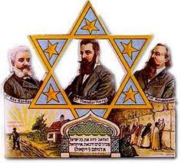
Conflicting Nationalisms: Arabs, Israelis and the Palestinian Question
In the aftermath of the Holocaust, many supported Zionist demands for creation of a Jewish state
Arab resistance to more Jewish immigration made Britain limit it
The Zionist military force, the Haganah, then began a violent resistance to British government
1937- British commission proposed partition of Palestine, was approved by the United Nations in 1948
Arab states attacked Israel but they were able to defend their new nation and expand at the expense of their Arab neighbors

Slide 25
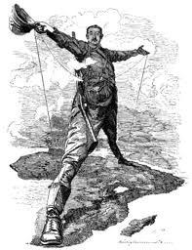
Conclusion: The limits of Decolonization
In many parts of the world, decolonization was not a revolutionary procedure
Power passed from one class of elites to another.
Little social and economic reform was involved
Decolonization did little to disrupt Western economic dominance of the system of global trade

